Slide 1
Wake on LAN using Gestures
TinyML Project by Loh Seng

Slide 2
About this Project
Control Raspberry Pi and connected PC using the Arduino Nano
Using IMU and Capacitive Button
RGB LED to show the status of the Arduino Nano
Demonstrates the ability to turn on a PC using external sensors
Alternate means to turn on without using the conventional power on/off button
Notes:
Aside: Reason for this project - Came from a laptop that I own, the power button failed after dismantling to replace the thermal paste

Slide 3
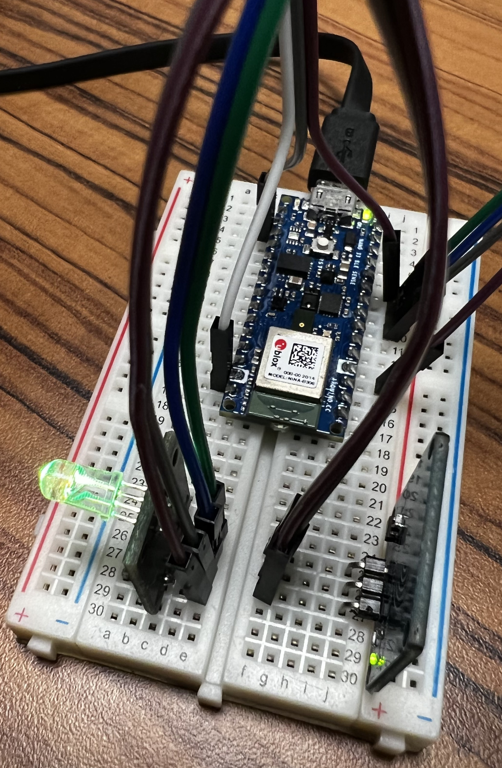
Hardware used
Arduino Nano 33 Sense BLE
Raspberry Pi 4 Model B (4GB)
Capacitive Touch Sensor
RGB LED
Dell Latitude 7490
With Wake-on-LAN enabled in BIOS/UEFI

Slide 4
Features implemented
Touching the Capacitive Button – Turns on the connected computer
Lifting the Arduino – Turns on the connected computer
Twisting motion on the Arduino – Reboot the Raspberry Pi
If TensorFlow Libraries cannot load – Shutdown the Raspberry Pi (To reduce power consumption)

Slide 5
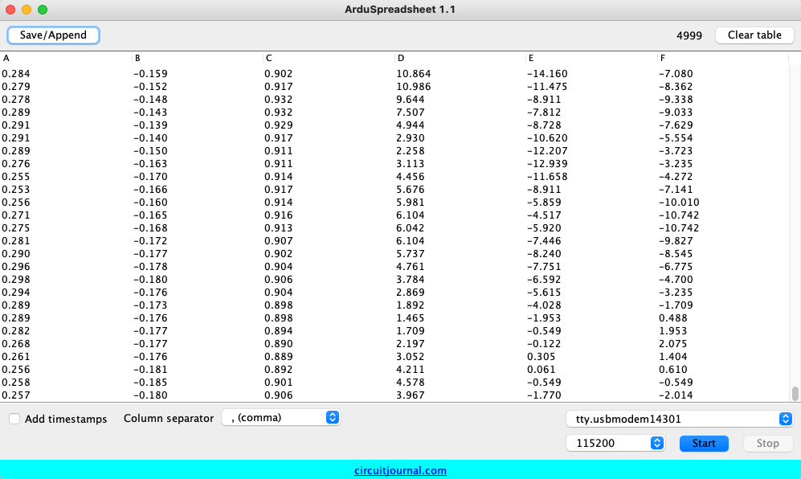
Data Collection & Training Process
At least 40 repeated twisting and lifting motions were recorded during training
Training data was recorded using ArduSpreadsheet
8 models were developed
To find a balance between accuracy and performance

Slide 6
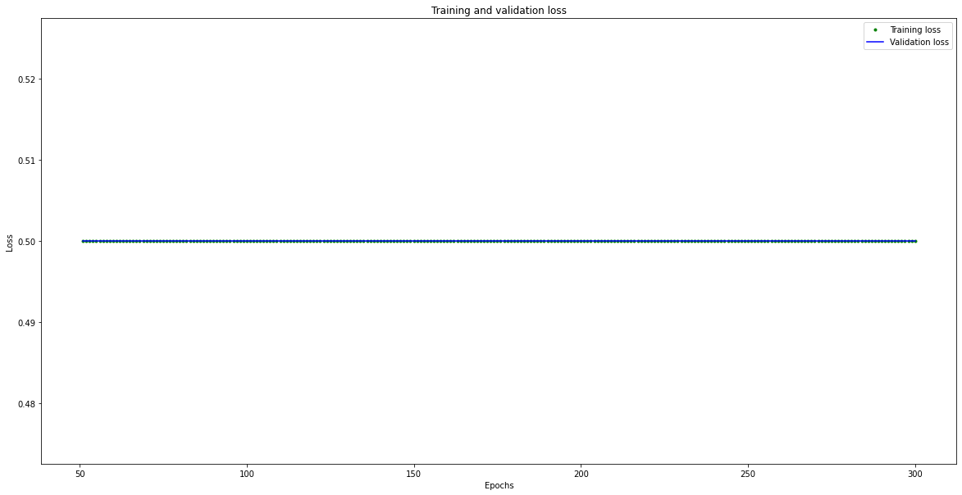
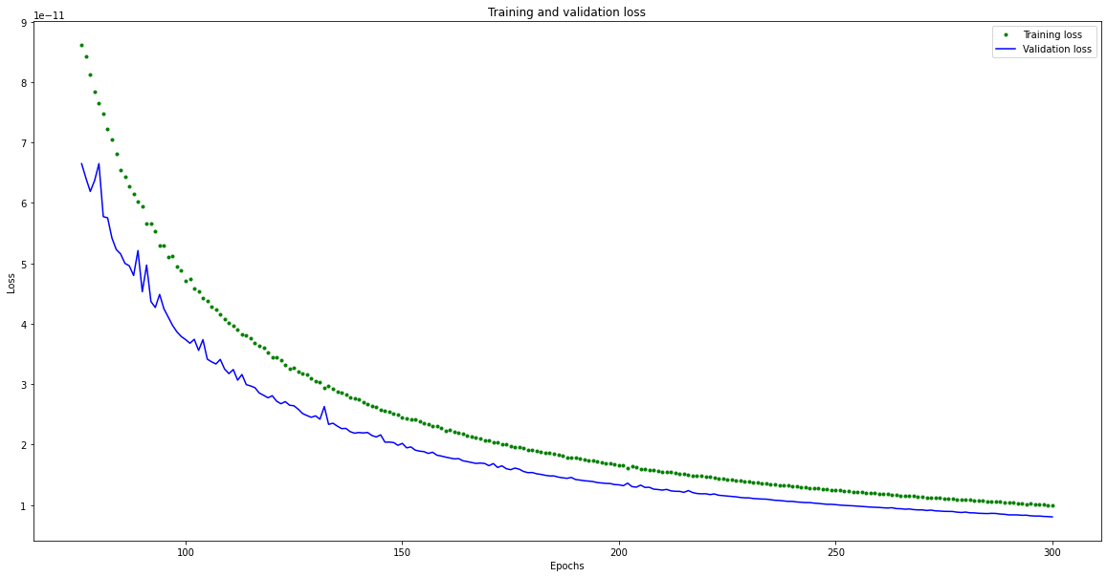
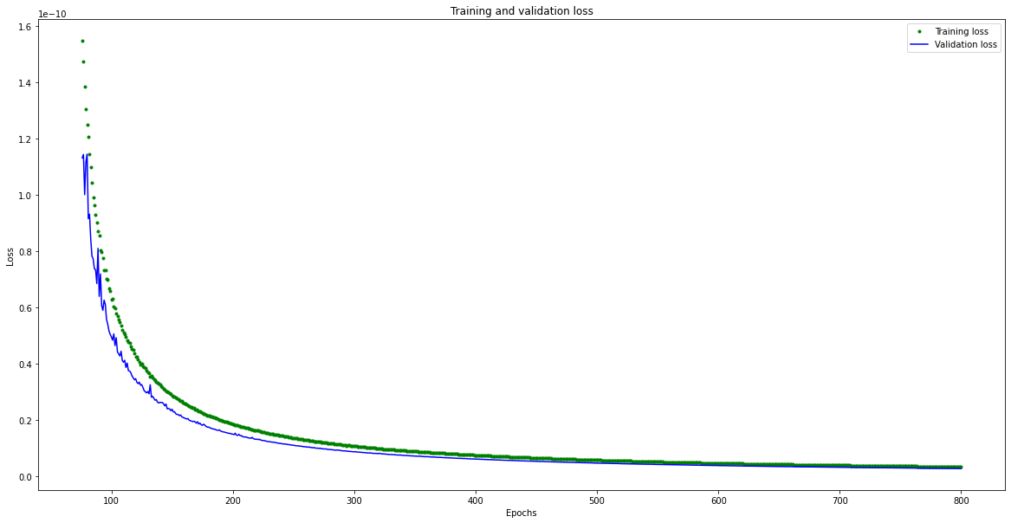
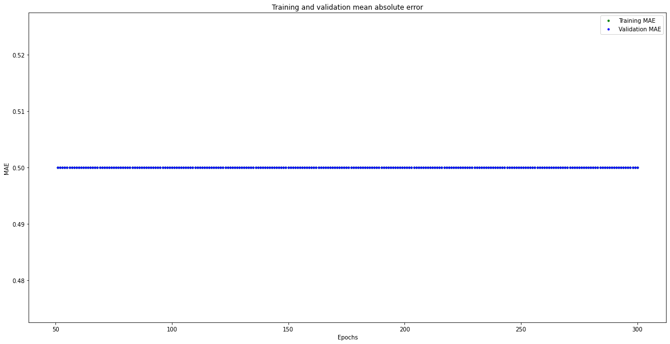
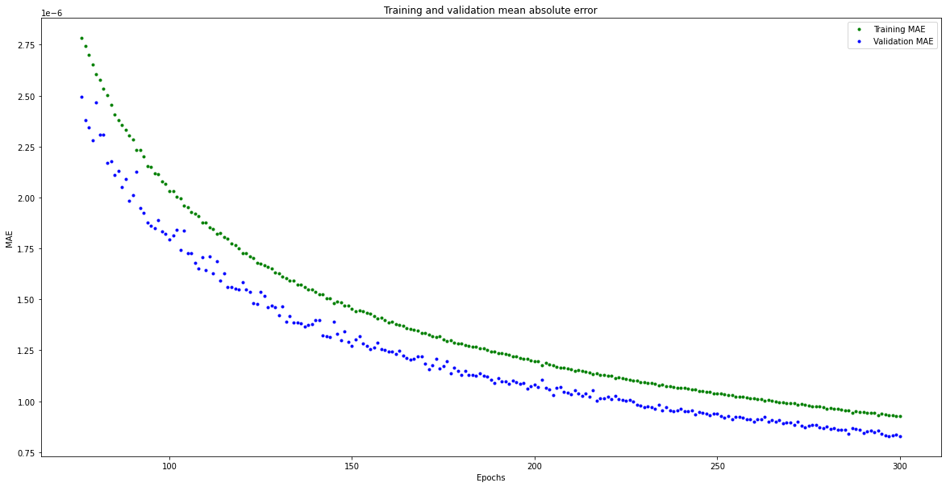
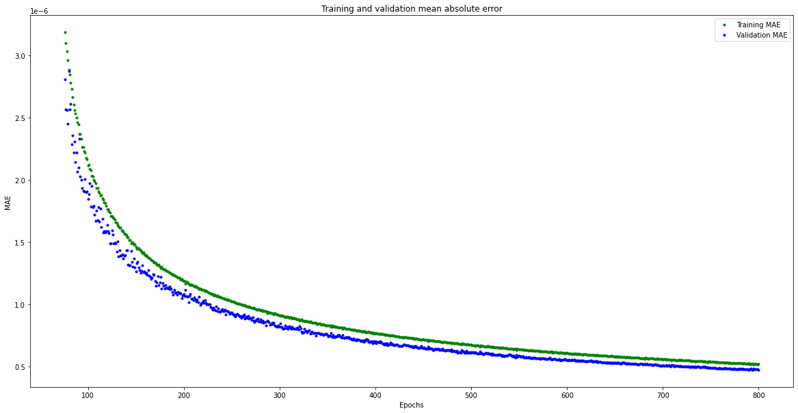
Training Process (1)
8 Models were developed
The updated model is based the previous results
Model 1
Model 2
Model 3

Slide 7

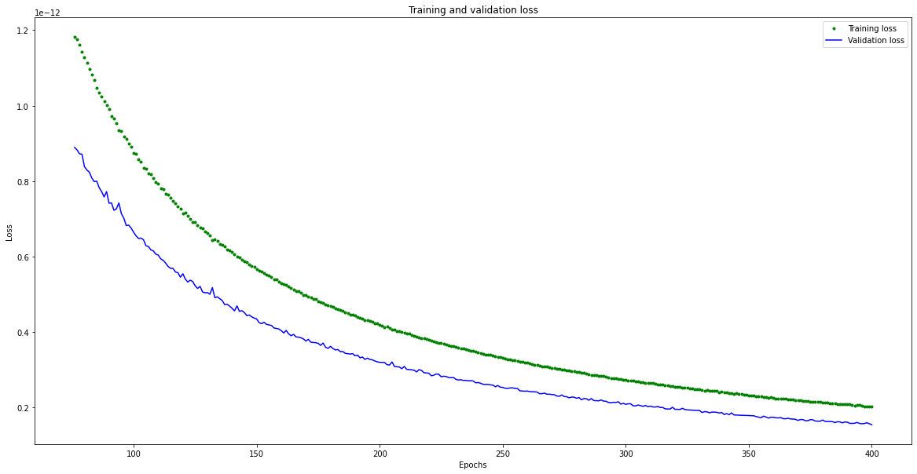
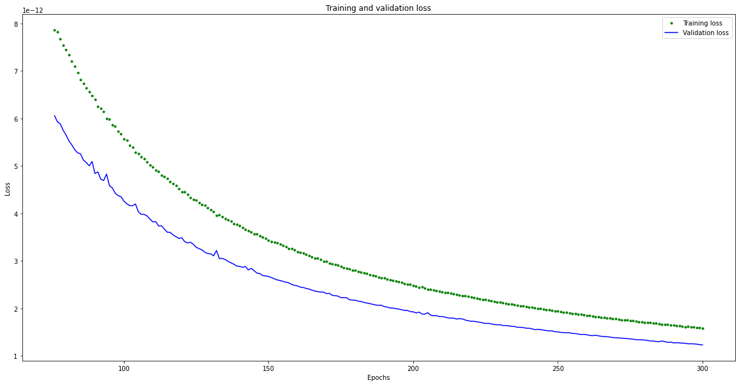
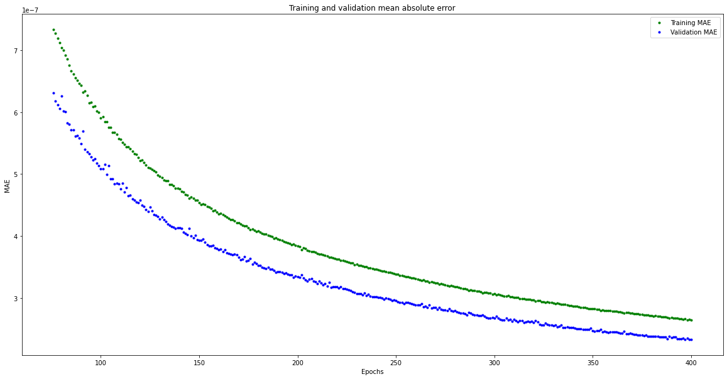
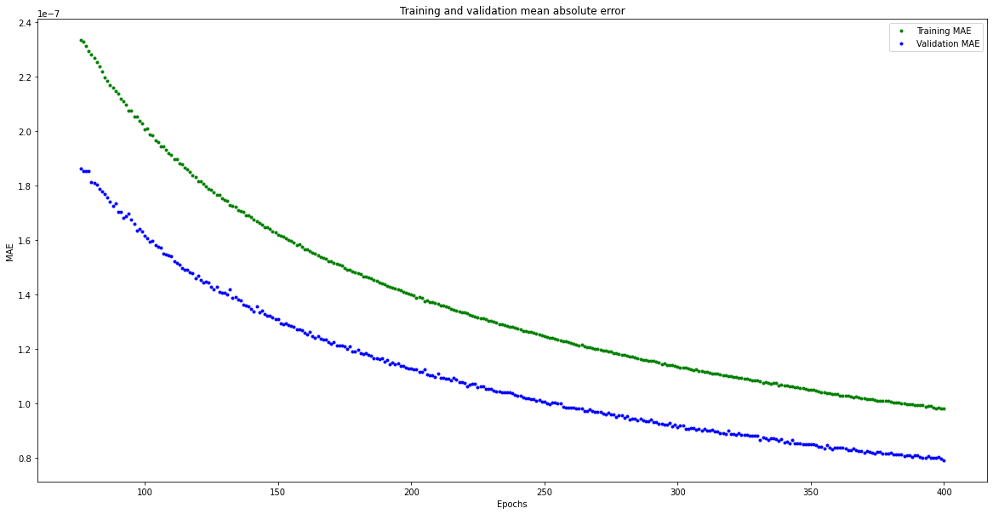
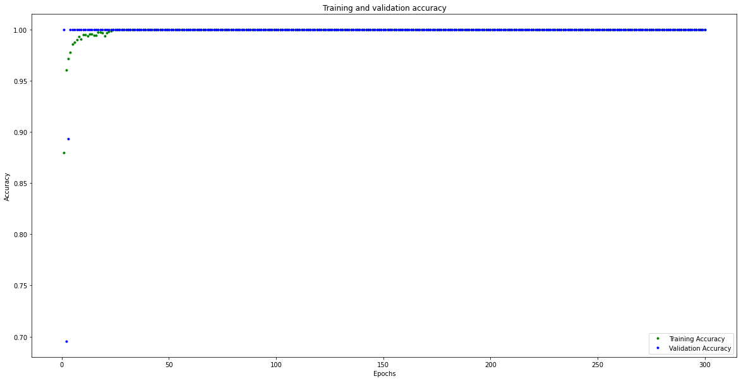
Training Process (2)
8 Models were developed
The updated model is based the previous results
Model 4
Model 5
Model 6

Slide 8
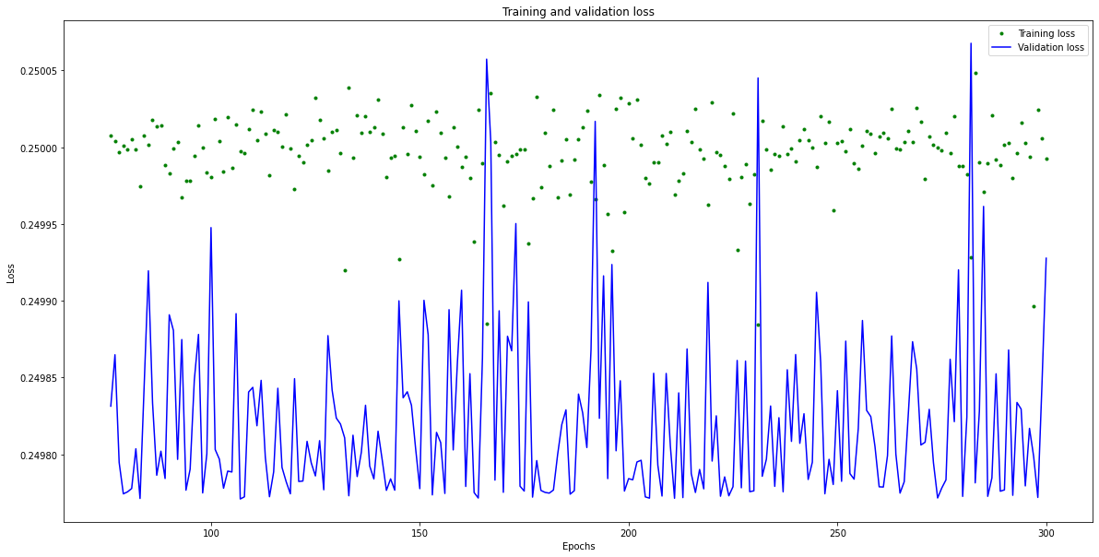
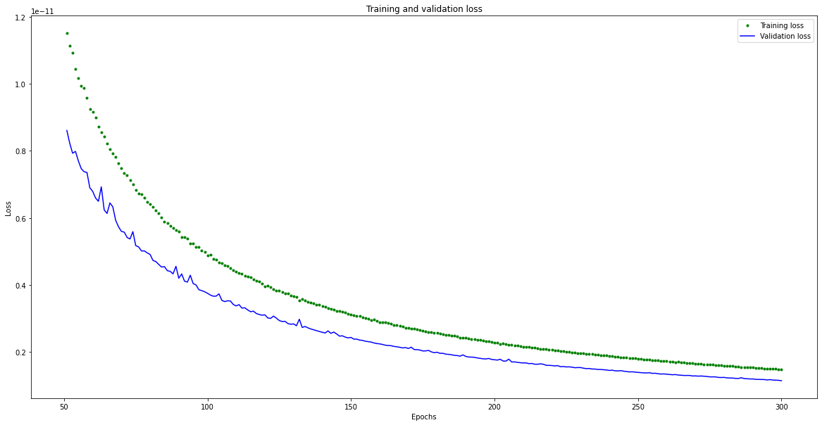
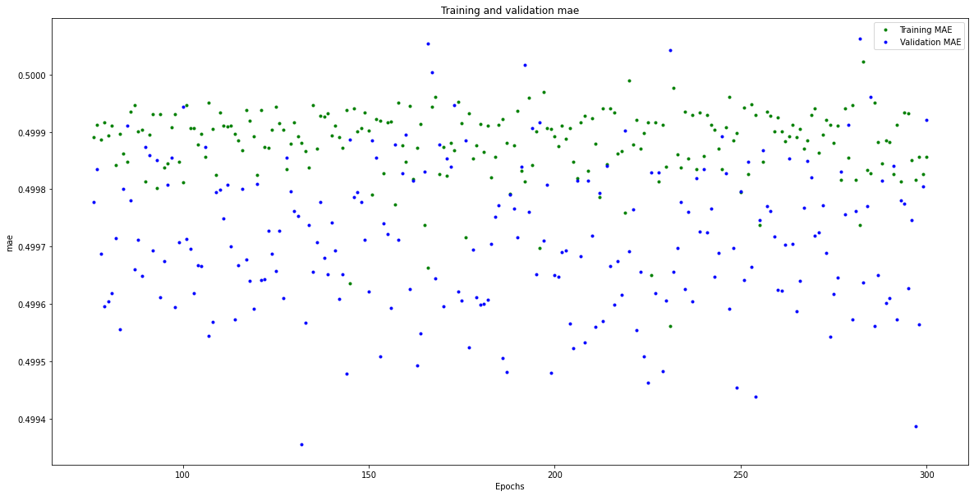
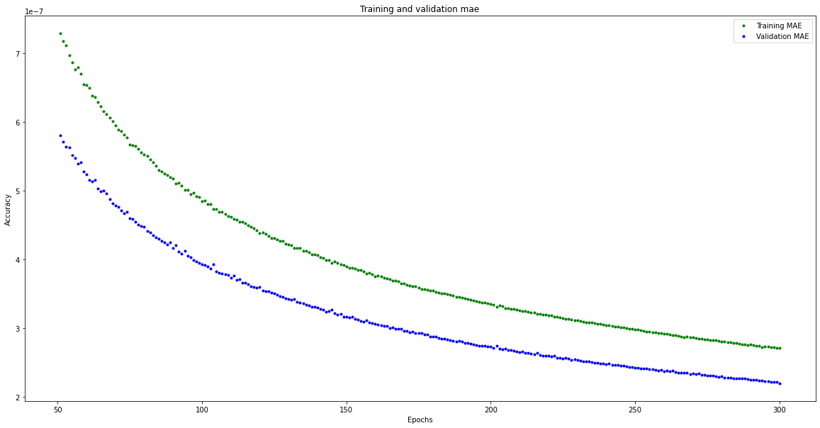
Training Process (3)
8 Models were developed
The updated model is based the previous results
Results:
Model with best accuracy comes with significant training time
More neurons does not mean increased accuracy
Model 7
Model 8

Slide 9
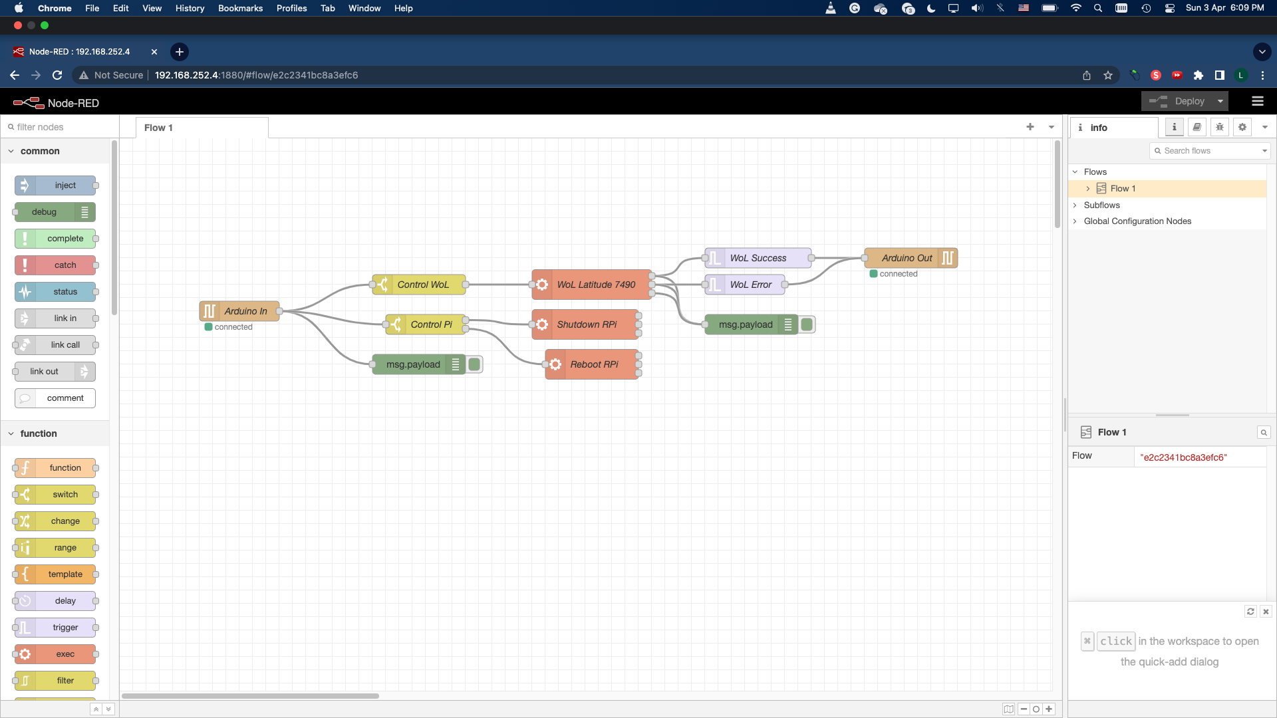
Communication between Raspberry Pi and Arduino
Serial Communication was created through the micro-USB cable
Bidirectional communications allowed
Installed Node-RED on the Raspberry Pi to send and receive messages
Will execute relevant functions when receiving appropriate messages

Slide 10
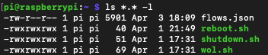
Functions deployed in Node-RED
WoL Latitude 7490:
Message required: “<turnon>”
Turns on the connected laptop through etherwake
Shutdown RPi:
Message required: “<shutdown>”
Turns off the Raspberry Pi to save power when the Arduino Nano is unable to do inference
Reboot RPi:
Message required: “<reboot>”
Restarts the Raspberry Pi upon request
Files deployed in Raspberry Pi for operations
”flows.json”: Configuration file for Node-RED
“reboot.sh”: Shell script for Reboot RPi
“shutdown.sh”: Shell script for Shutdown RPi
“wol.sh”: Shell script for WoL Latitude 7490

Slide 11
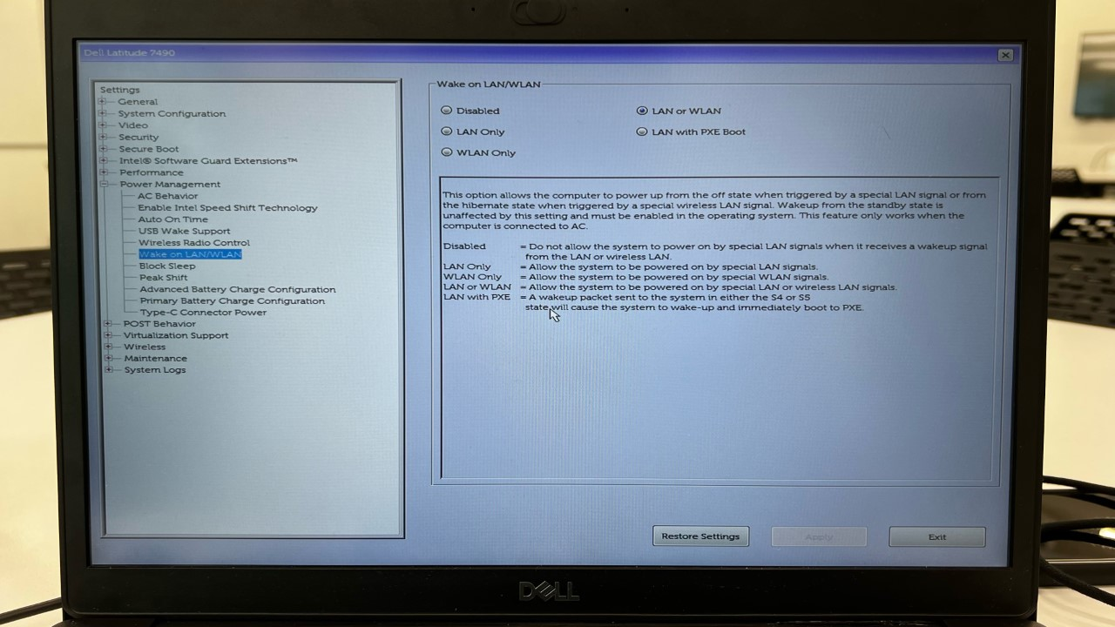
Communication between Raspberry Pi and the connected computer
Through Wake-on-LAN Protocol
A Magic Packet is sent from Raspberry Pi to the Computer
The Computer will turn on / resume upon receiving the packet
However, this assumes the following:
BIOS/UEFI and Operating System have Wake on LAN enabled
Ethernet Port is enabled when the device is off-state
Windows 10/11 users should disable Hybrid Shutdown (Fast Startup) when setting up

Slide 12
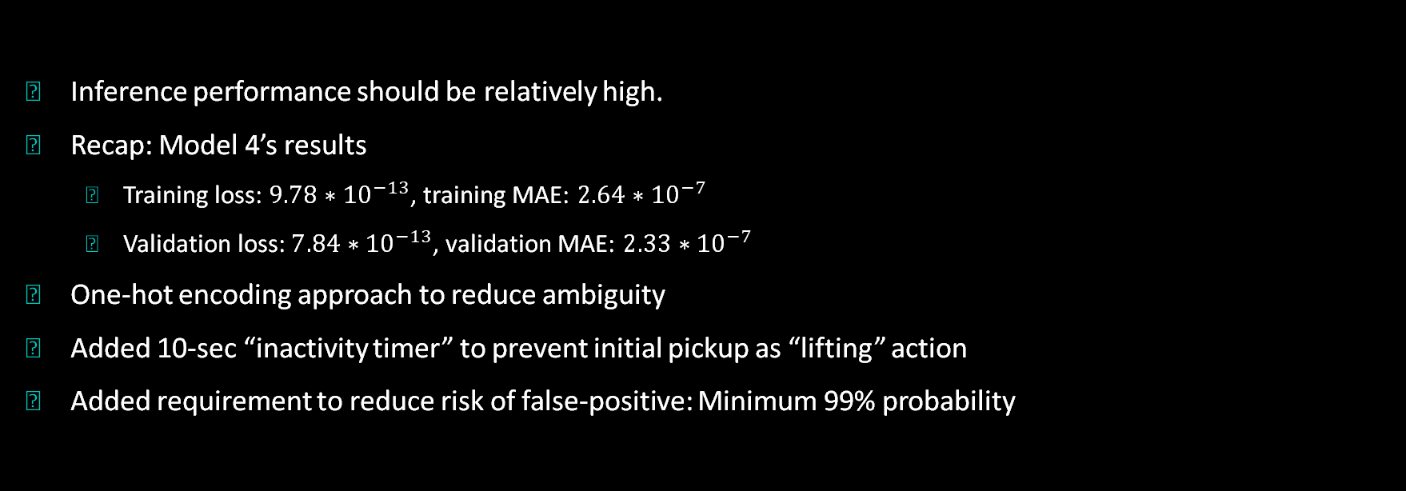
Inference Performance
Inference performance should be relatively high.
Recap: Model 4’s results
Training loss: $9.78∗{10}^{−13}$, training MAE: $2.64∗{10}^{−7}$
Validation loss: $7.84∗{10}^{−13}$, validation MAE: $2.33∗{10}^{−7}$
One-hot encoding approach to reduce ambiguity
Added 10-sec “inactivity timer” to prevent initial pickup as “lifting” action
Added requirement to reduce risk of false-positive: Minimum 99% probability

Slide 13
Optimization Techniques – Code Size Minimization
Chose to deploy Model 4
Faster to train than Model 5, but slightly less accurate
Lesser neurons than Model 8
Added Full Integer Quantization to reduce code size even further
Further code size minimization is possible through importing of required operations into “MicroOpsResolver”
Not implemented here as it might cause reduction in functionality or cause microcontroller to crash during runtime if implemented incorrectly.

Slide 14
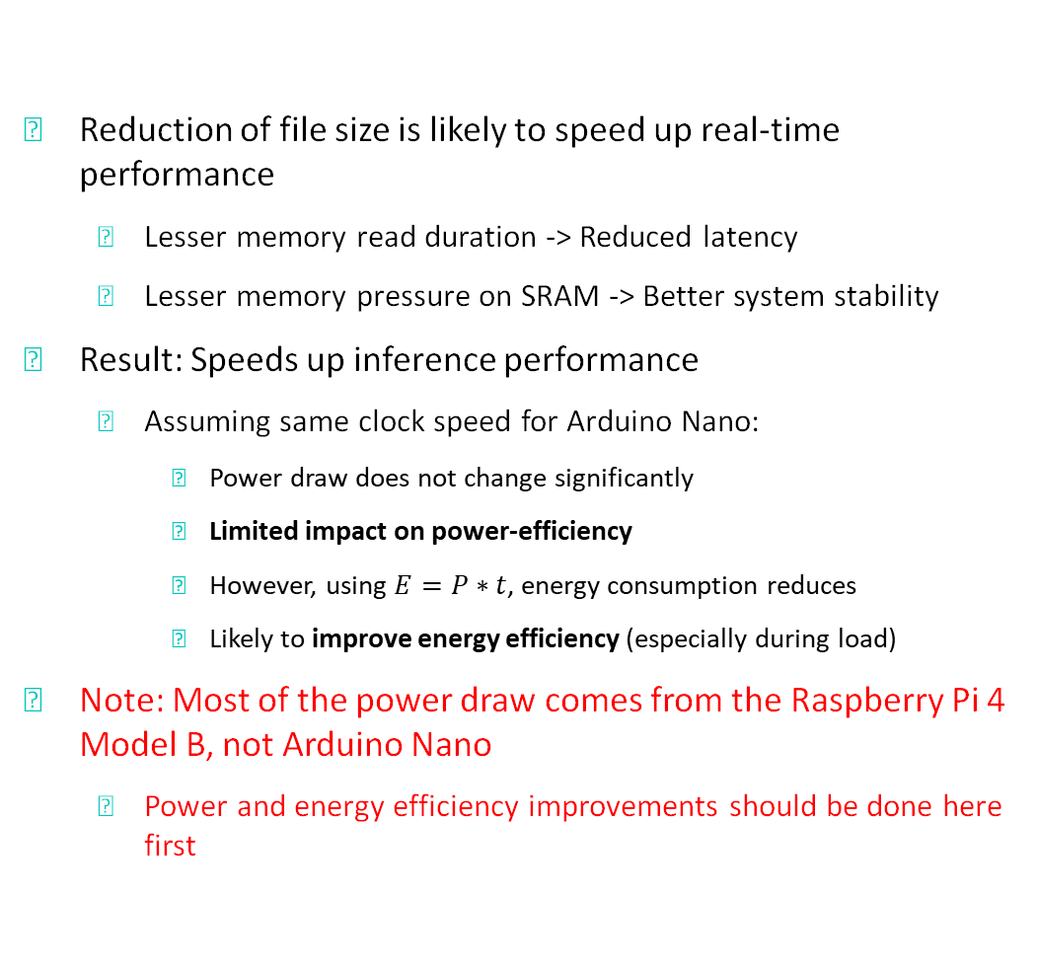
Optimization Techniques – Real-time Performance and Power-efficiency optimization
Reduction of file size is likely to speed up real-time performance
Lesser memory read duration -> Reduced latency
Lesser memory pressure on SRAM -> Better system stability
Result: Speeds up inference performance
Assuming same clock speed for Arduino Nano:
Power draw does not change significantly
Limited impact on power-efficiency
However, using $E=P∗t$, energy consumption reduces
Likely to improve energy efficiency (especially during load)
Note: Most of the power draw comes from the Raspberry Pi 4 Model B, not Arduino Nano
Power and energy efficiency improvements should be done here first

Slide 15
DEMO TIME!

Slide 16
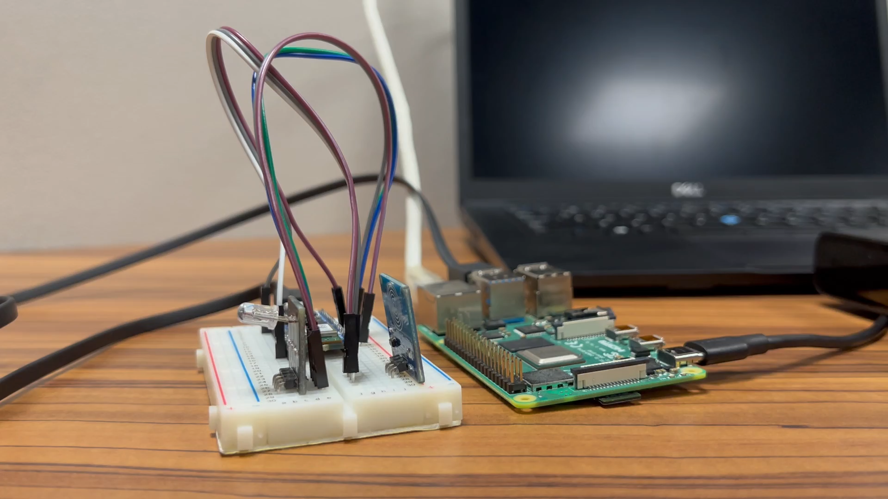
Booting up Raspberry Pi and Arduino Nano

Slide 17
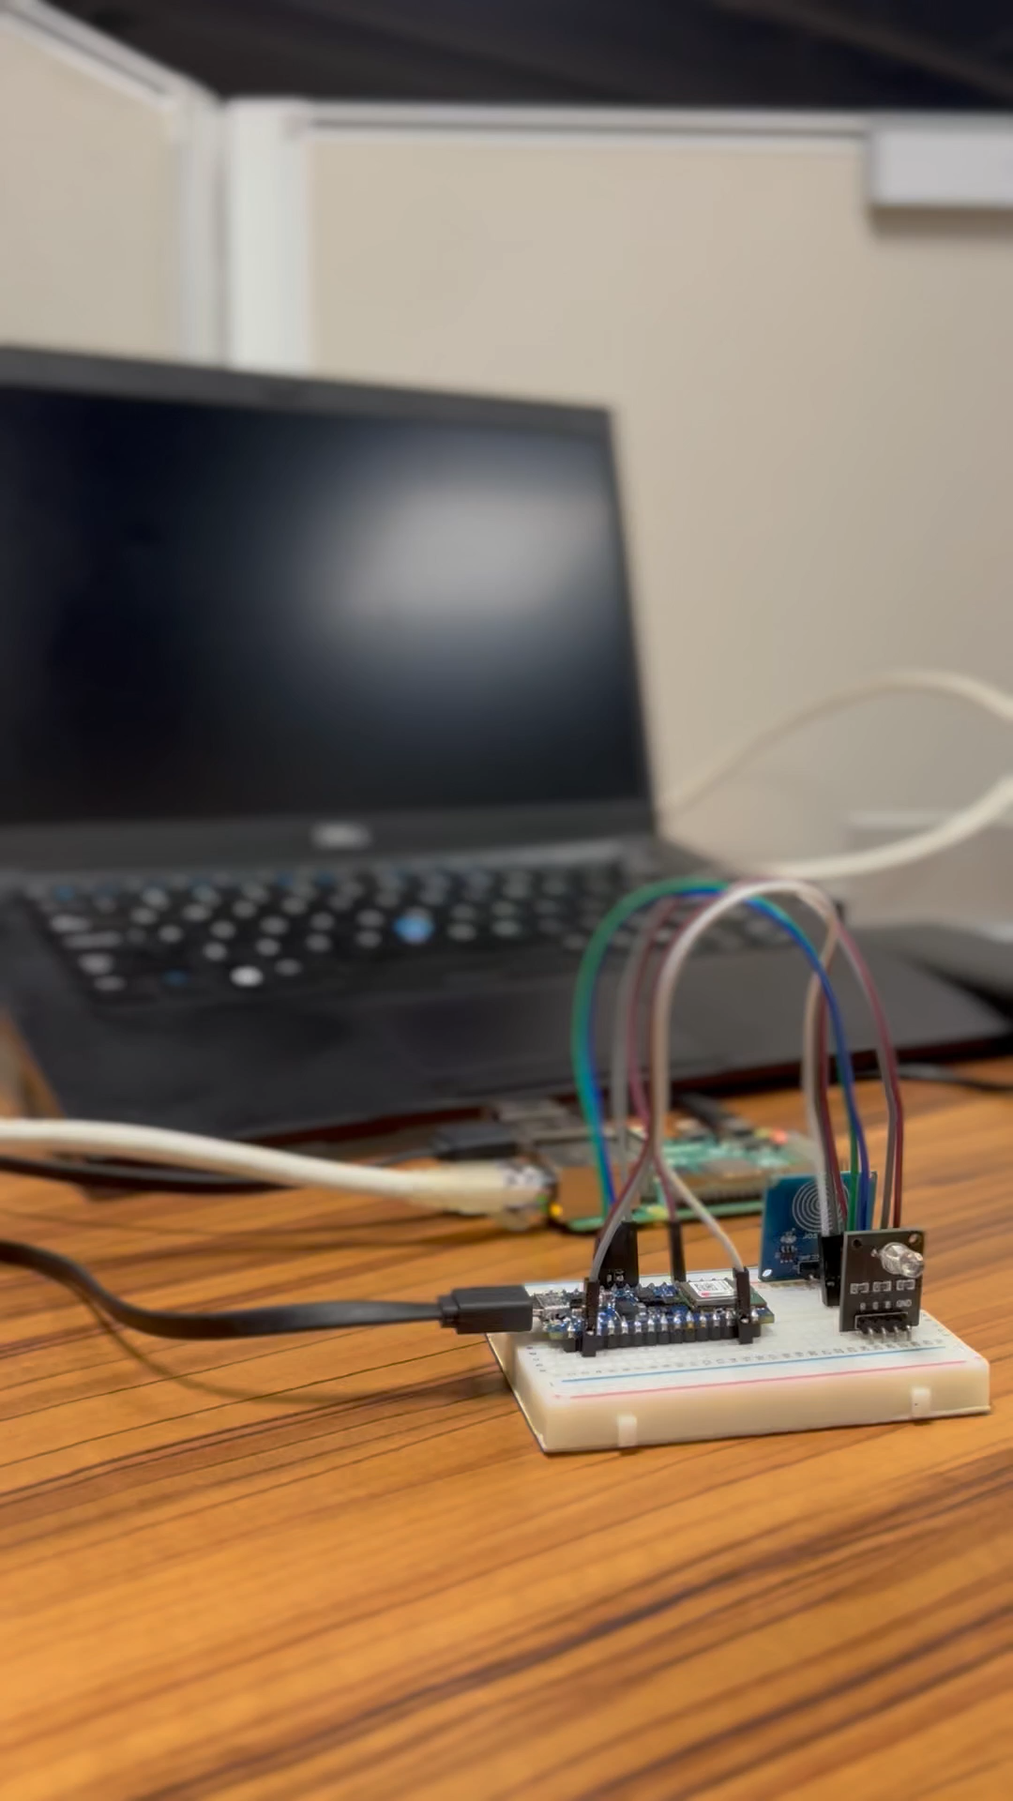
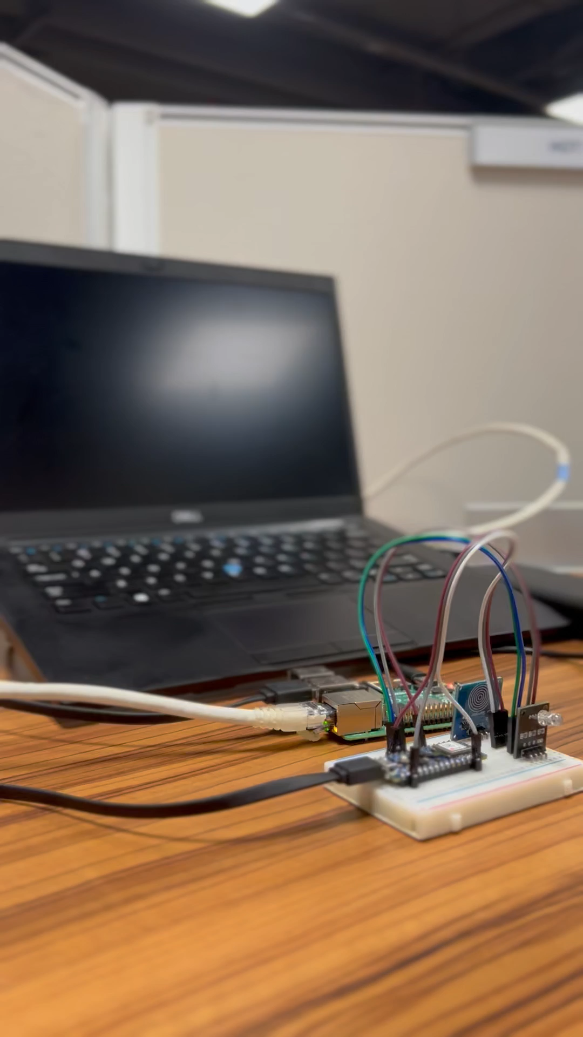
Turning on the computer

Slide 18
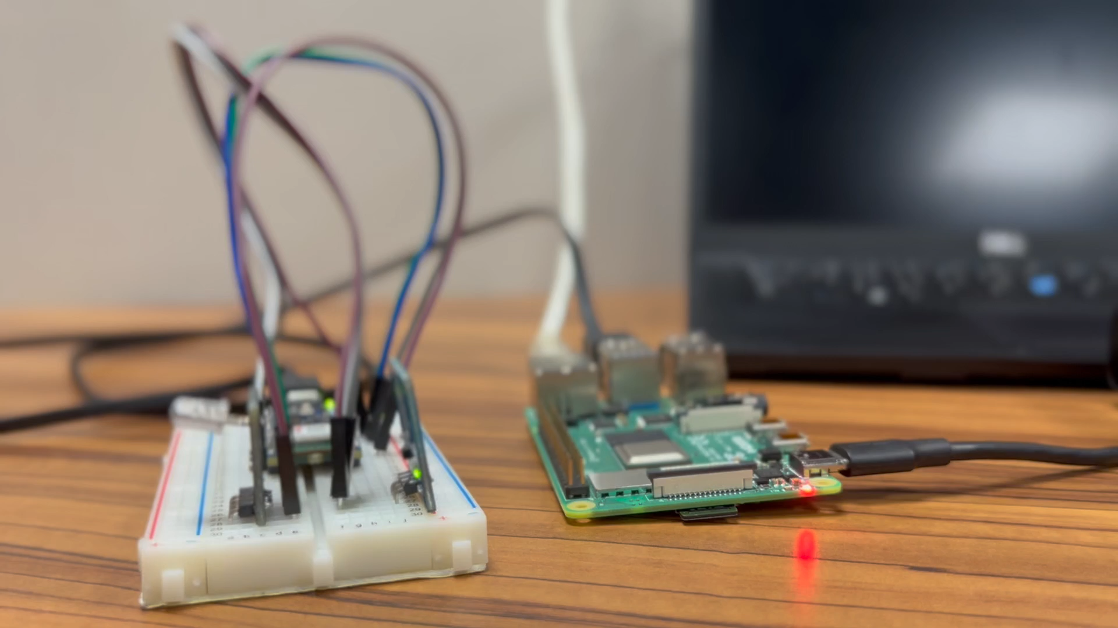
Shutting off the Raspberry Pi

Slide 19
Possible Future Work
Method 1: Optimizations on Raspberry Pi 4
Headless and GUI-less setup should reduce power consumption especially during idle
Reduce clock speed [Default: 1.5-1.8GHz quad-core]

Slide 20
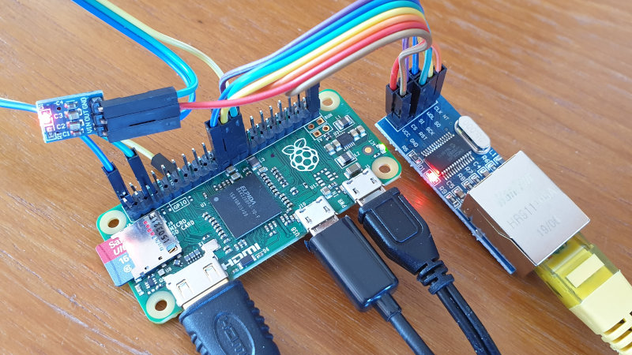
Possible Future Work
Method 2: Use lower-powered Single Board Computers (SBCs)
Deploy on Raspberry Pi 3 Model B and before
Minimal reconfigurations are required
Idle power consumption is still relatively high
Deploy on Raspberry Pi Zero 2 W with Ethernet GPIO module
Likely to require configuration and shell script modifications
Similar performance as Pi 3 Model B but with significantly lower power consumption
Background Picture: Attachment of ENC28J60 Ethernet Controller to Raspberry Pi Zero via GPIO. Source: https://www.raspberrypi-spy.co.uk/2020/05/adding-ethernet-to-a-pi-zero/

Slide 21
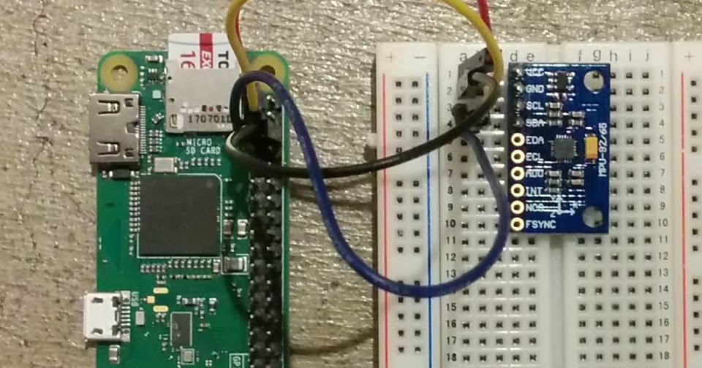
Possible Future Work
Method 3: Replace Arduino with external IMU attachment on Raspberry Pi
Remove USB overhead
Inference on Raspberry Pi
Possible result:
Faster inference performance
Lesser power draw during idle
Slightly increased peak-load power-draw
Background Picture: Attachment of MPU9250 to Raspberry Pi Zero via GPIO. Source: https://asukiaaa.blogspot.com/2018/04/raspberry-pi-mpu9250.html

Slide 22
Conclusion
Deployed Arduino as a sensing device to control Raspberry Pi
Raspberry Pi execute different commands through Node-RED

Slide 23
Thank You!

